Slide 1
Embedded Systems and IoT
Introduction to Embedded Systems; Day -1
By- Chandramouli Haldar

Slide 2
What is an Embedded System?
An embedded system is a specialized computing device designed for a specific task within a larger mechanical or electrical system
Unlike general-purpose computers, these systems combine hardware and software to perform dedicated functions often in real-time such as washing machine, Home Automation, or operating a medical device
Why embedded ? because it is a specialized computer system integrated within a larger mechanical or electrical product to perform a specific function

Slide 3
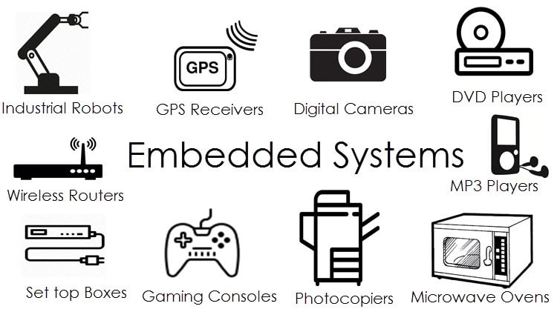

Slide 4
Why Do We Need Embedded Systems?
To automate tasks
To make devices smart
To reduce human effort
To work fast and reliably
Compact and lightweight design
Cost-effective solutions

Slide 5
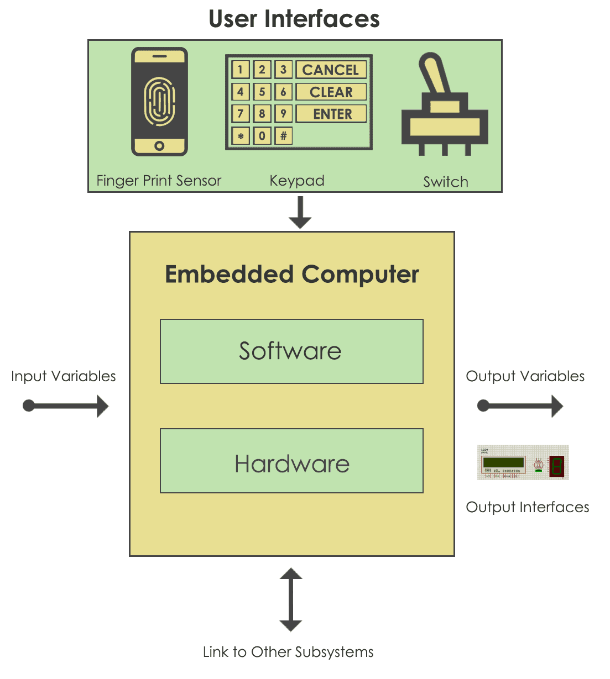
How Does an Embedded System Work?
Input → Process → Output

Slide 6
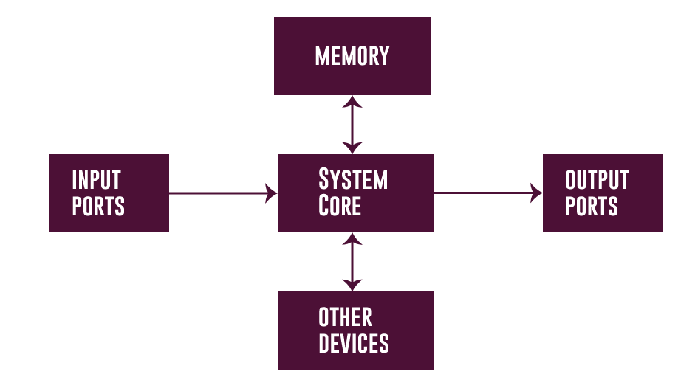
Components of Embedded Systems

Slide 7
1. What is an Embedded System?
A) A general-purpose computer B) A specialized system designed for specific tasks C) A gaming console D) A networking device
2. Which of the following is NOT an Embedded System?
A) Washing machine B) Microwave oven C) Desktop computer D) ATM machine
3. Why do we use Embedded Systems?
A) To increase device size B) To automate tasks and improve efficiency C) To consume more power D) To slow down processes
4. How does an Embedded System work?
A) Output → Input → Process B) Input → Process → Output C) Process → Output → Input D) Input → Output → Process
5. What are the core components of an Embedded System?
A) CPU, Monitor, Keyboard B) Input, Processor, Output, Power Supply, Software C) Only Software D) Only Hardware

Slide 8
1. What is an Embedded System?
A) A general-purpose computer B) A specialized system designed for specific tasks ✅ C) A gaming console D) A networking device
2. Which of the following is NOT an Embedded System?
A) Washing machine B) Microwave oven C) Desktop computer ✅ D) ATM machine
3. Why do we use Embedded Systems?
A) To increase device size B) To automate tasks and improve efficiency ✅ C) To consume more power D) To slow down processes
4. How does an Embedded System work?
A) Output → Input → Process B) Input → Process → Output ✅ C) Process → Output → Input D) Input → Output → Process
5. What are the core components of an Embedded System?
A) CPU, Monitor, Keyboard B) Input, Processor, Output, Power Supply, Software ✅ C) Only Software D) Only Hardware

Slide 9
Characteristics of an Embedded System
Performs specific task: Embedded systems perform some specific function or tasks.
Low Cost: The price of an embedded system is not so expensive.
Time Specific: It performs the tasks within a certain time frame.
Low Power: Embedded Systems don't require much power to operate.
High Efficiency: The efficiency level of embedded systems is so high.

Slide 10
Characteristics of an Embedded System
Minimal User interface: These systems require less user interface and are easy to use.
Less Human intervention: Embedded systems require no human intervention or very less human intervention.
Highly Stable: Embedded systems do not change frequently mostly fixed maintaining stability.
High Reliability: Embedded systems are reliable they perform tasks consistently well.

Slide 11
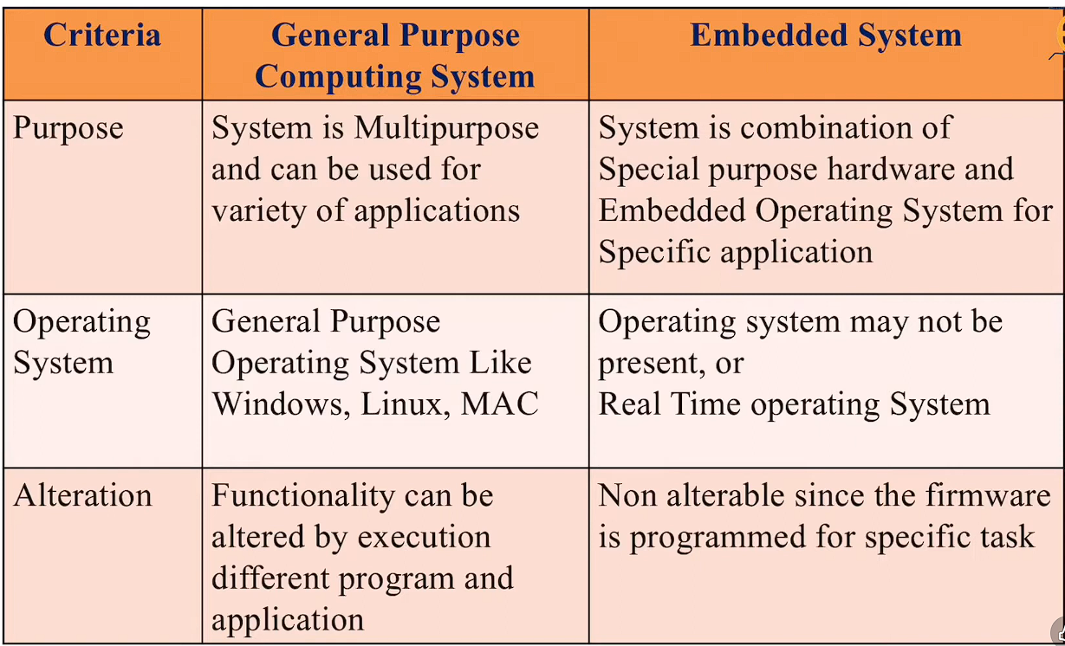

Difference Between General Purpose Computer vs Embedded systems

Slide 12
Advantages / Disadvantages of Embedded systems
Advantages | Disadvantages
High Efficiency and Performance | Limited Processing Power
Low Power Consumption | Limited Flexibility and Upgradability
Compact Size | Development Complexity
Cost-Effectiveness | Cost of Development (Initial)
Real-Time Capabilities | Scalability Issues
Reliability and Stability: | Maintenance and Support

Slide 13
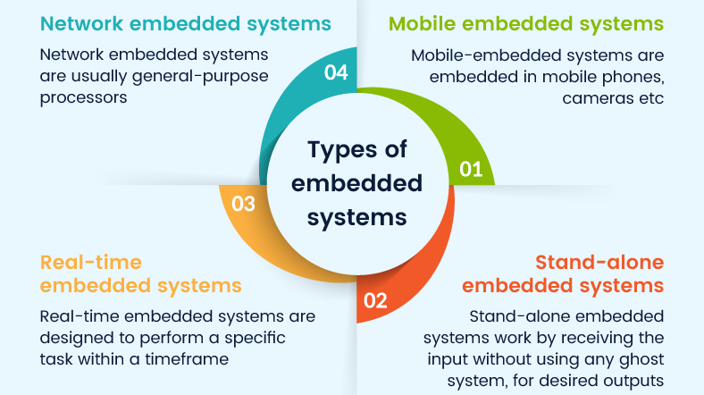

Slide 14
Which is a characteristic of an embedded system? A) General-purpose usage B) Performs specific tasks C) High power consumption D) Large size
Embedded systems are designed to: A) Perform multiple unrelated tasks B) Perform a specific task C) Run heavy software D) Store large data
One advantage of embedded systems is: A) High power consumption B) Low efficiency C) High efficiency and performance D) Large size
A disadvantage of embedded systems is: A) High flexibility B) Limited processing power C) Large size D) High energy use
Which of the following is an example of a real-time embedded system? A) Digital clock B) Heart rate monitor in ICU C) Calculator D) MP3 player
Which of the following is NOT a standalone embedded system? A)Digital camera B) Microwave oven C) Washing machine D) Network router

Slide 15
Which is a characteristic of an embedded system? A) General-purpose usage B) Performs specific tasks ✅ C) High power consumption D) Large size
Embedded systems are designed to: A) Perform multiple unrelated tasks B) Perform a specific task ✅ C) Run heavy software D) Store large data
One advantage of embedded systems is: A) High power consumption B) Low efficiency C) High efficiency and performance ✅ D) Large size
A disadvantage of embedded systems is: A) High flexibility B) Limited processing power ✅ C) Large size D) High energy use
Which of the following is an example of a real-time embedded system? A) Digital clock B) Heart rate monitor in ICU ✅ C) Calculator D) MP3 player
Which of the following is NOT a standalone embedded system? A)Digital camera B) Microwave oven C) Washing machine D) Network router ✅

Slide 16
Components of an Embedded System
An embedded system mainly has:
Input Devices
Processor (Microcontroller)
Output Devices
Power Supply
Software

Slide 17
1. Input Devices
What is Input? Input is how an embedded system receives information.
Examples:
Switch
Button
Temperature sensor
Light sensor
Keypad
Role: Sends data/signals to the microcontroller

Slide 18
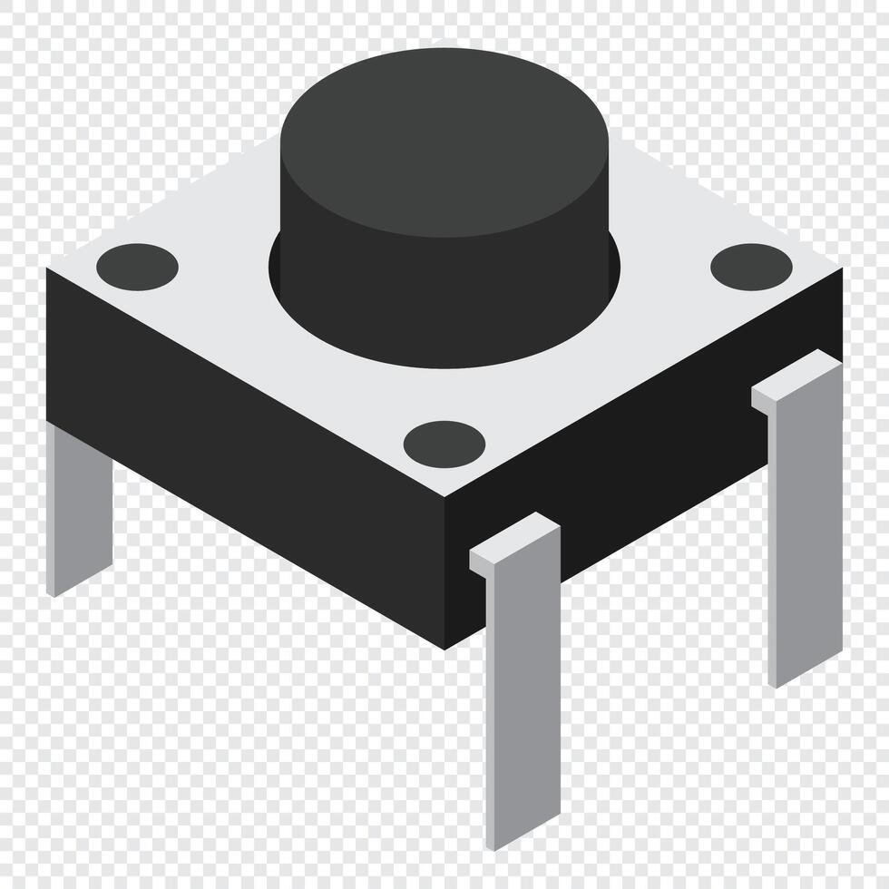
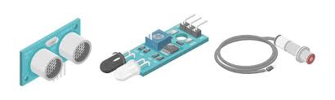
How Input Devices Work?
Example: Button
Button pressed → signal changes
Microcontroller detects HIGH / LOW
Program responds
Example: Sensor
Physical change → electrical signal
Signal goes to microcontroller

Slide 19
2. Processor (Microcontroller)
Microcontroller = Brain
What it does:
Reads input data
Processes data using program
Controls output devices
Examples:
8051, Atmega, Arduino

Slide 20
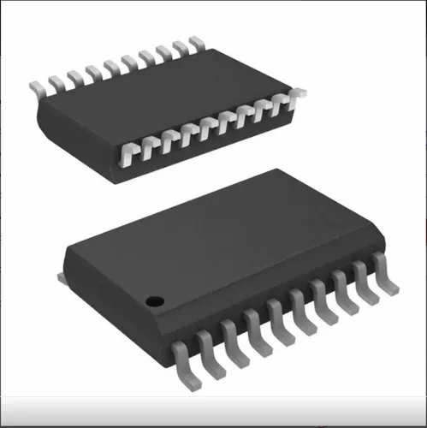
How Microcontroller Works?
Step-by-step:
Reads input from pins
Executes program (logic)
Decides what to do
Sends signal to output
Use Input → Logic → Output

Slide 21
3. Output Devices
What is Output? Output is how the system shows results.
Examples:
LED
LCD display
Motor
Buzzer
Relay
Role: Acts based on controller decision

Slide 22

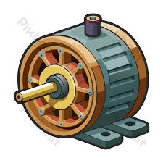
How Output Devices Work?
Example: LED
Controller sends signal
LED ON / OFF
Example: Motor
Controller controls driver
Motor rotates or stops
Keep it very practical.

Slide 23

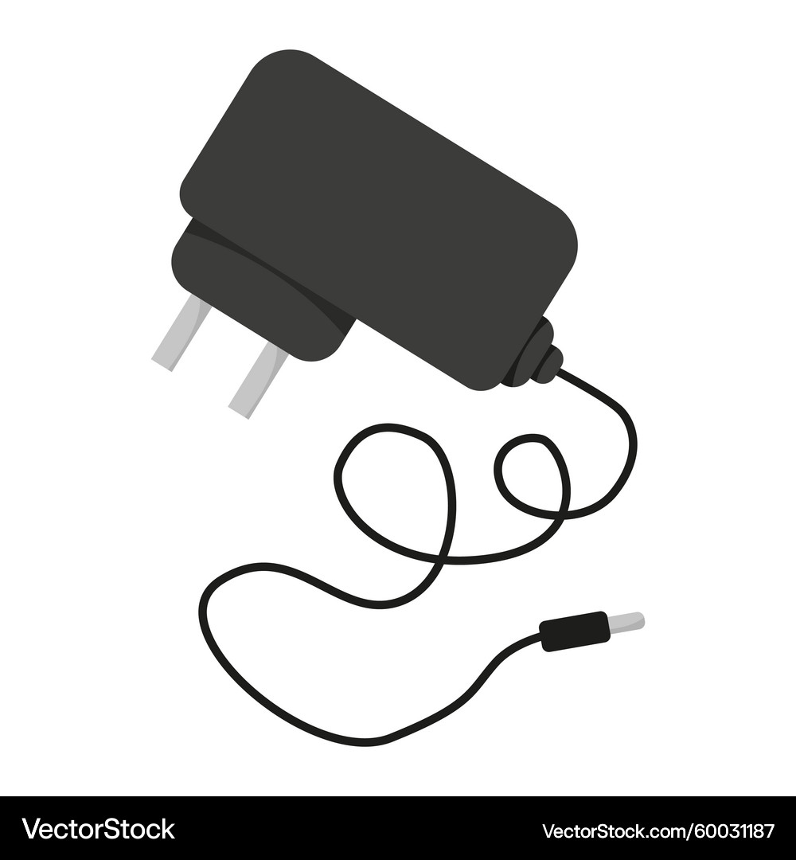
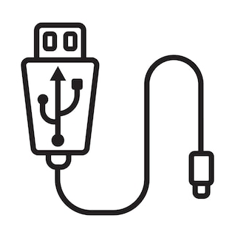
4. Power Supply
Why power supply is important
Provides required voltage
Ensures stable operation
Common sources:
Battery
Adapter
USB
Remember: “Wrong power = dead system.”

Slide 24

5. Software (Program)
Software tells hardware what to do
Written using:
Embedded C
Arduino code
Assembly (later)
Without software:
Hardware is mostly useless

Slide 25
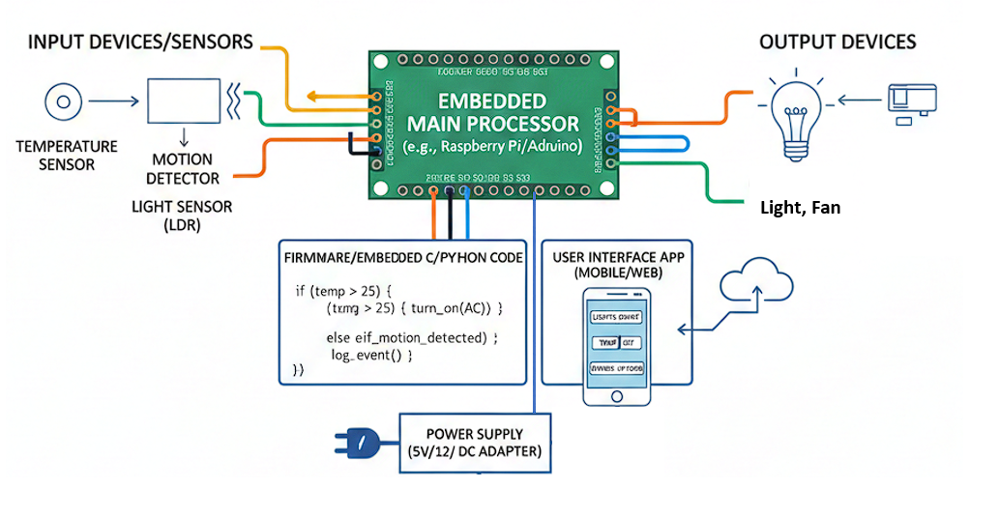
Example 1. Home automation

Slide 26
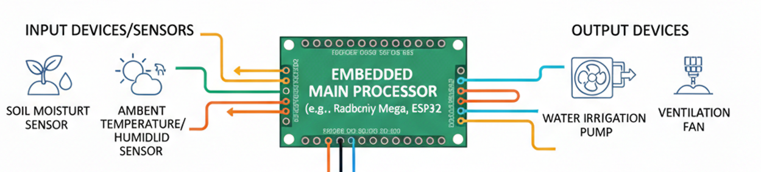
Example 2. Smart Agriculture

Slide 27
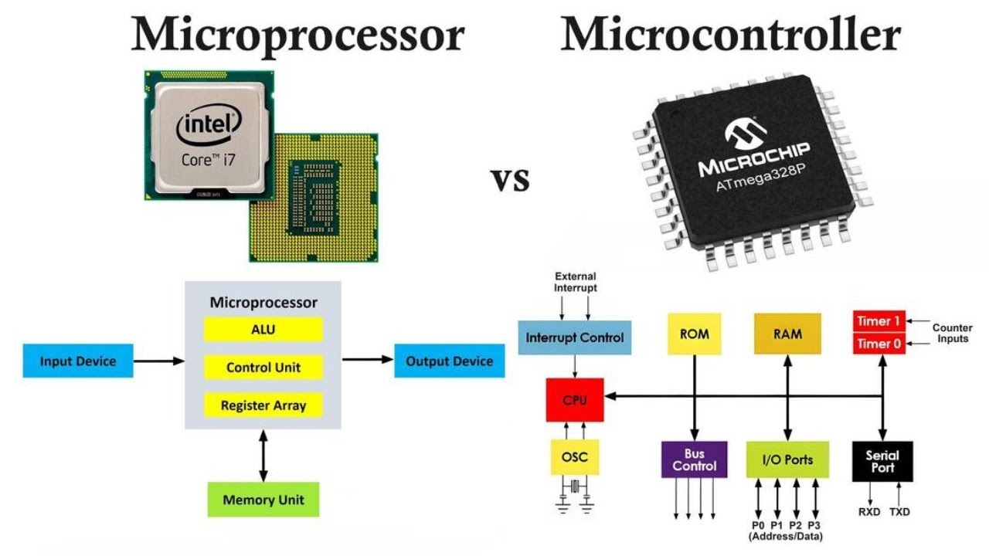

Slide 28
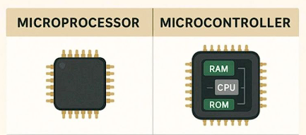
Microcontroller VS microprocessor
Microcontroller units (MCUs) and microprocessor units (MPUs) are two kinds of integrated circuits that, while similar in certain ways also very different in many others.
The key difference between these two units is that microcontrollers combine all the necessary elements like Memory, Storage, input/output (I/O) components into a single chip, and Microprocessor require all this externally to work.

Slide 29
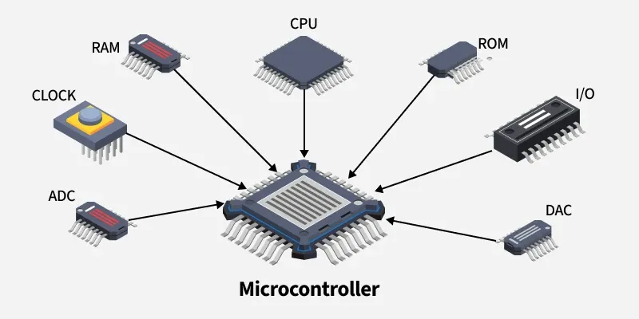
Microcontroller
Microcontroller is a small computer on a single chip, containing a processor core, operational memory (RAM) and electrically erasable programmable read-only memory (EEPROM) for program memory, some I/O interfaces, and ADCs (Analog to Digital converters.

Slide 30
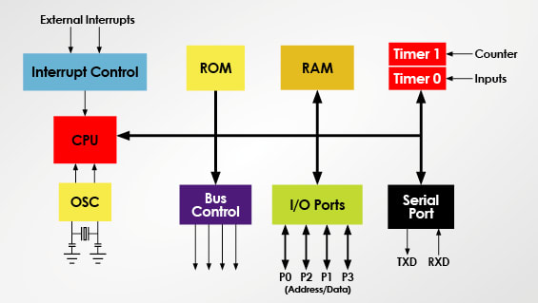
Components of a Microcontroller

Slide 31
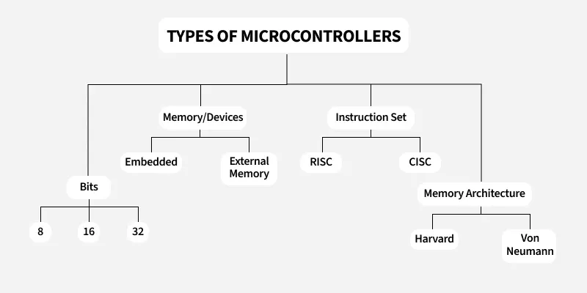

Slide 32
Types of Microcontrollers Based on Number of Bits
8-bit Microcontrollers
Can process 8 bits of data at a time, only work within (0–255)
Used for: Simple control tasks. Basic embedded projects
Examples: 8051, PIC 1x, MC68HC11
16-bit Microcontrollers
Can process 16 bits of data at a time, handles larger numbers than 8-bit
Used for: Medium-level embedded systems, Industrial controllers
Examples: PIC 2x, Intel 8096
32-bit Microcontrollers
Can process 32 bits of data at a time, Very fast and powerful
Used for:
Medical devices, Advanced embedded applications
Examples: Atmel 251 family, PIC 3x
*Bit size = how much data the microcontroller can handle at one time.

Slide 33
Types of Microcontrollers Based on Memory Type
Embedded Memory Microcontroller
Everything is inside one chip
Includes: Program memory, Data memory, I/O ports, Timers & counters
Compact design, Less external hardware, Easy to use
Example: 8051 microcontroller
External Memory Microcontroller
Some parts are outside the chip
Important point: Program memory is connected externally
Bigger circuit ,More components required
Example: 8031 microcontroller

Slide 34
Types of Microcontrollers Based on Instruction Set
CISC (Complex Instruction Set Computer)
One instruction can do many operations
Advantages: Fewer lines of code, Shorter programs
Disadvantage: Instructions are complex Slower execution in some cases
Example “One command does many jobs.”
RISC (Reduced Instruction Set Computer)
Uses small and simple instructions
Advantages: Faster execution, Less clock cycles per instruction, Better performance
Why faster? Instructions are simple and optimized
Example “Many small steps, but very fast.”

Slide 35
Types of Microcontrollers Based on Memory Architecture
Harvard Architecture Microcontroller
Program memory and data memory are separate
Advantages: Faster execution, Can access program and data at the same time
Used in: Most modern microcontrollers
Example “Two separate roads → no traffic.”
Von Neumann Architecture Microcontroller
Program and data share same memory
Advantages: Simple design, Low cost
Disadvantages: Slower performance
Example “One road → traffic possible.”

Slide 36
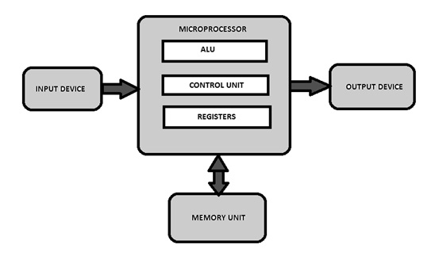
Microprocessor
A Microprocessor is a programmable device that takes in input, performs some arithmetic and logical operations over it and produces the desired output. In simple words, a Microprocessor is a digital device on a chip that can fetch instructions from memory, decode and execute them, and give results.

Slide 37
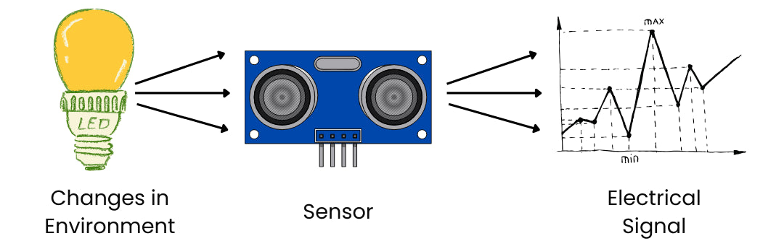
Sensor
A sensor is a device that detects physical, or environmental input—such as light, heat, motion, moisture, or pressure—and converts it into a signal, typically electrical, that can be measured, interpreted, or used to trigger a response

Slide 38
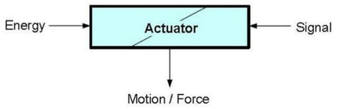
Actuators
Actuator is a device that converts the electrical signals into the physical events or characteristics. It takes the input from the system and gives output to the environment.
For example, motors and heaters are some of the commonly used actuators.

Slide 39
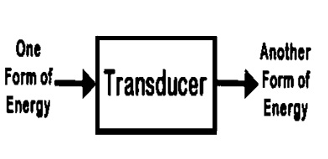
transducer
A transducer is a device that converts energy from one form into another, typically transforming physical quantities (such as pressure, temperature, light, or motion) into measurable electrical signals, or vice versa.
For Example: Microphone, Motor, etc.

Slide 40
Thank you !

